Slide 1
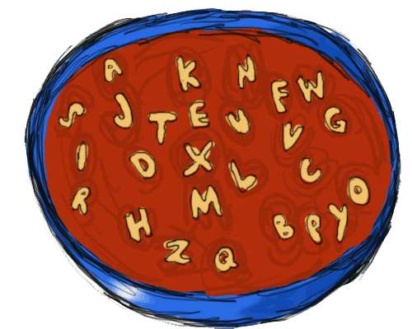
Alphabet Soup: Colleague Mnemonics for Faculty

Slide 2
What is Colleague?
Ellucian’s Colleague is a software system that manages student information, finances, and human resources.
Colleague is the information system that Self-Service, Slate, Coursedog, Simple Syllabus, Informer, and other systems pull information from—they interface with the system in more user-friendly ways.

Slide 3

Logging into Colleague
Go to the CCCC portal and click on the purple Ellucian icon:
Notes:
You’ll go in through the portal—look for the purple icon. This will open in your browser. If you need to use Colleague from home, you will need to apply for VPN access in Etrieve and access Colleague using an application called Appstream, also on the portal.

Slide 4
Top Navigation
Search for a person
Search for a form
Notes:
The search bar at the top of colleague is your best friend. You can use it to look for people and forms.

Slide 5
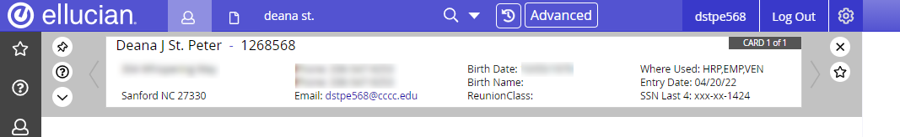
Search for a Person
Type last name, first name or first name last name
Results show ID, address, phone, CCCC email and other information

Slide 6
Forms/Screens
These screens contain information about courses, classes, students, budgets, expenditures, and other information.
Access the screens using mnemonics. Some of these are easy to remember (TSUM = “test-’em!” EVAL = “evaluate”); others, not so much.
Notes:
There are mnemonic “cheat sheets” on the Employee Hub

Slide 7

Student Information
This Photo by Unknown Author is licensed under CC BY

Slide 8
Common Forms for Student Information
ASUM = applicant summary
STAT = student academic transcript
STAC = student grades
PERC = holds
EVAL = program evaluation
SACP = student academic program
TSUM = test scores
RGN = registration
STSC = Student schedule

Slide 9
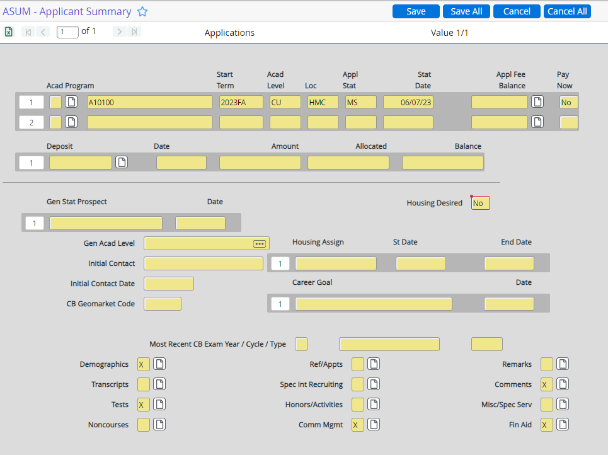
ASUM
FERPA Consent

Slide 10
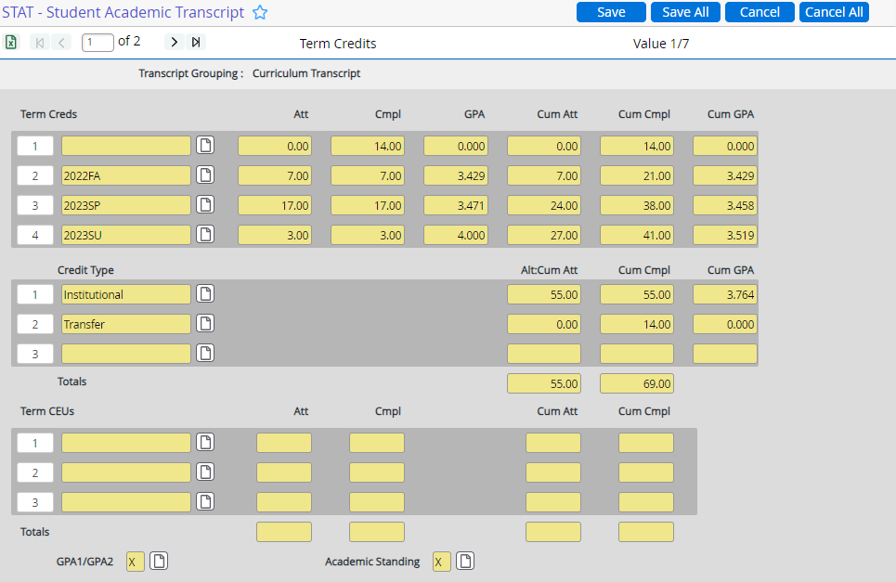
STAT

Slide 11
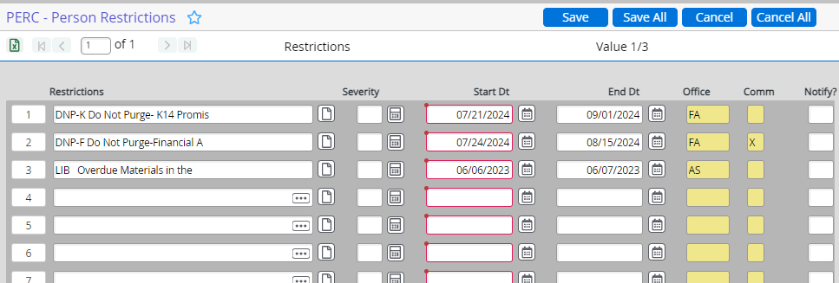
PERC = holds

Slide 12
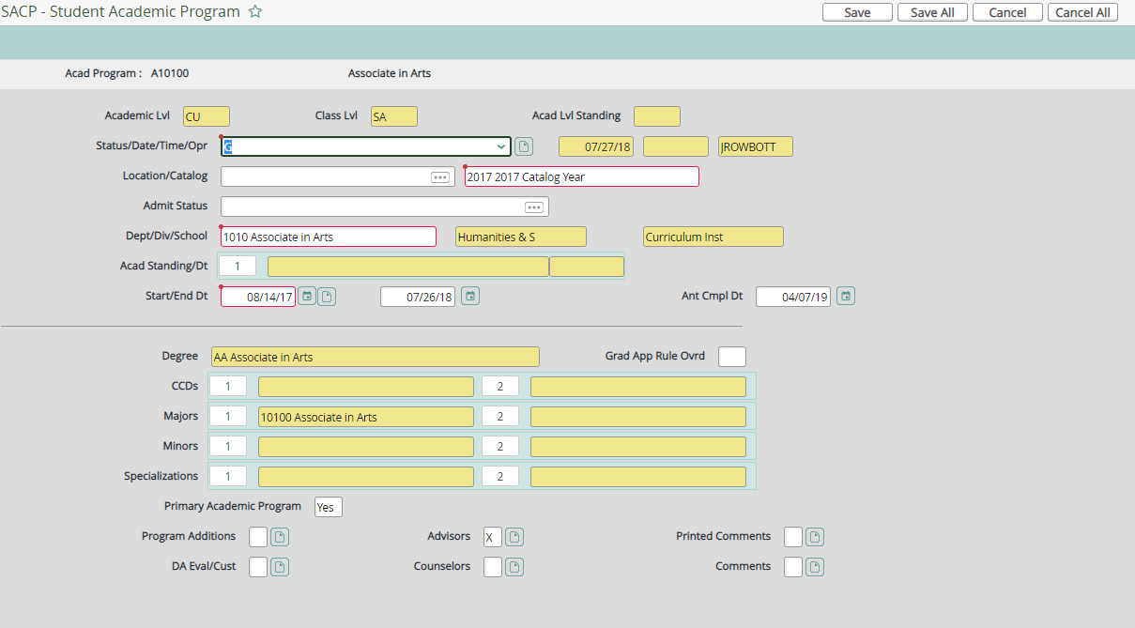
SACP = Program code + Catalog year

Slide 13
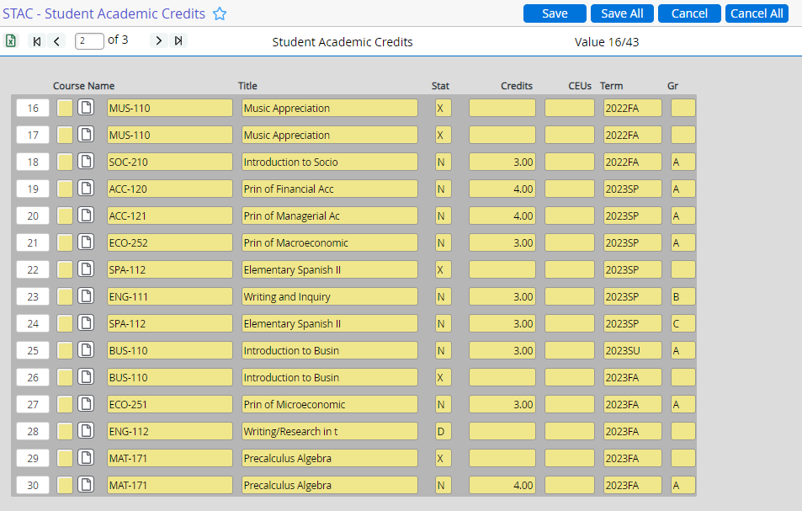
STAC = academic history/grades

Slide 14
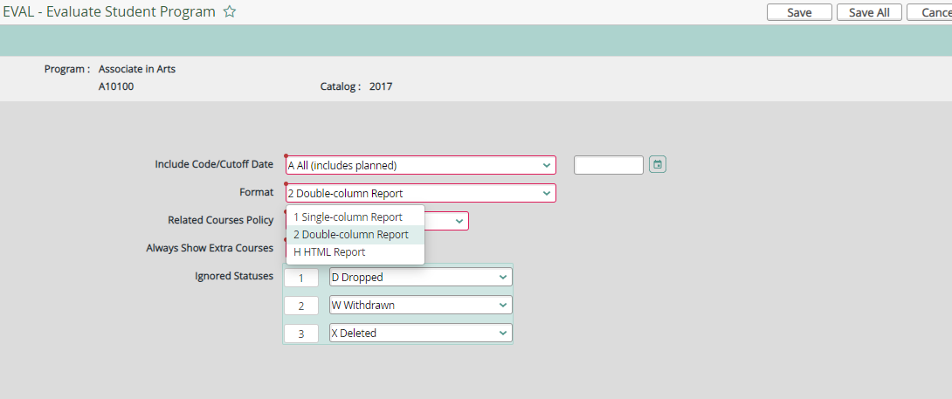
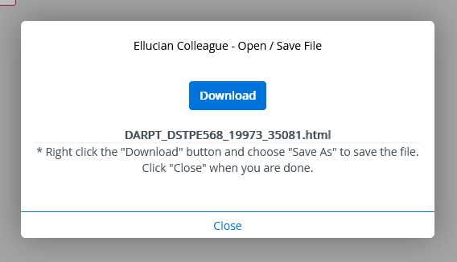
EVAL = program evaluation
Click on Format drop-down; click report type you’d like
Click Download

Slide 15
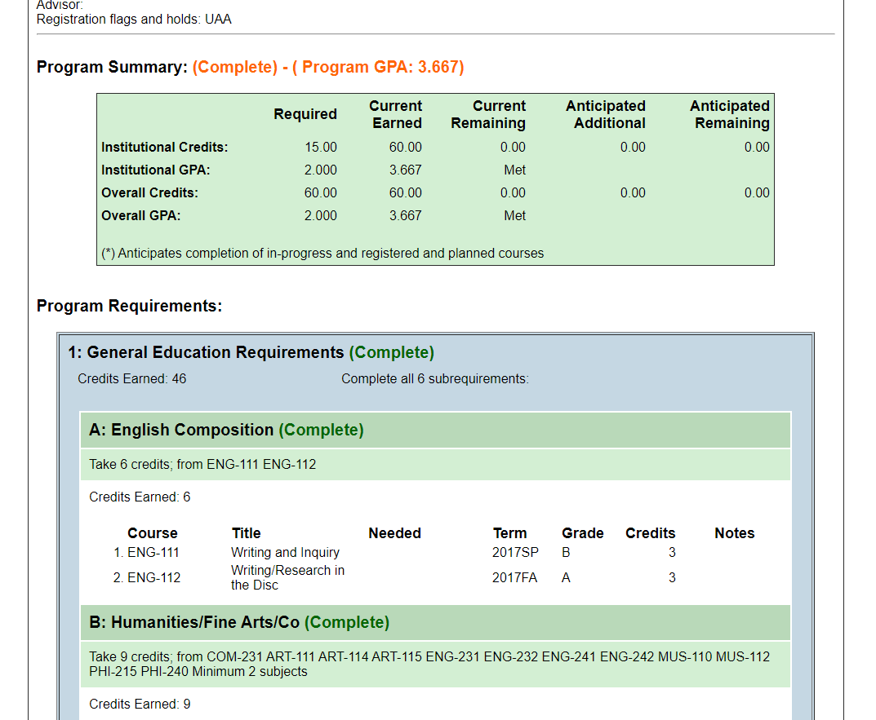
HTML (user-friendly version) of program EVAL
Lists courses completed/ in progress/ remaining

Slide 16
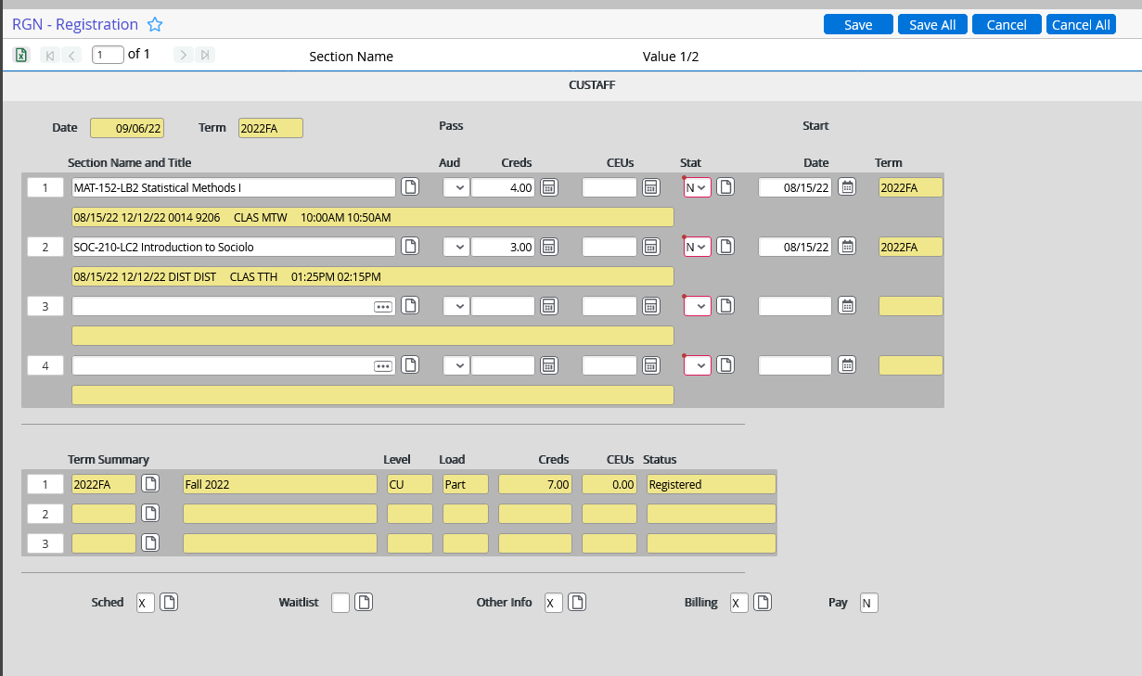
Start with semester (ex: 2026SP) to avoid registering student for the wrong term; then put in the course, ex: 2026SP aca-122, to see a list of sections.
View Schedule

Slide 17
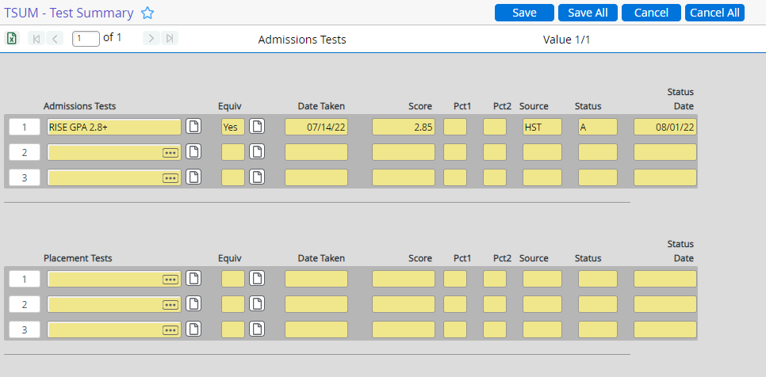
TSUM

Slide 18

Course Forms

Slide 19
Common Course Forms
RSTR = Roster of the students in the class
SROS = Roster with add/drop/withdraw and other details
SPRT = Prerequisite report

Slide 20
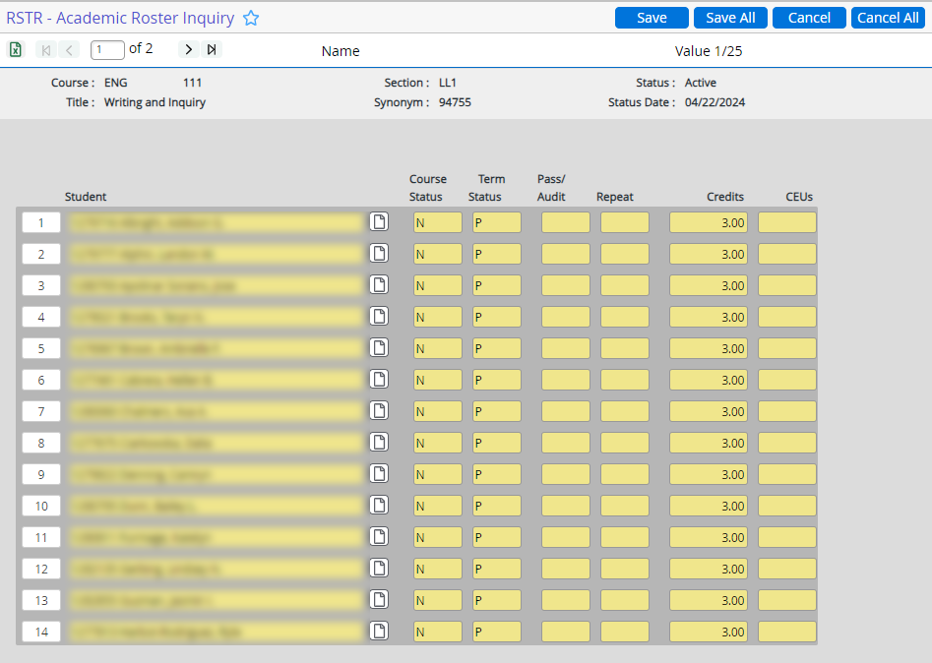
RSTR
Put in the course section (i.e., ACA-122-LB1)—limit to the current semester by putting that in first (2025fa ENG-111)
This returns a list of the students in the class.
You can export by clicking the Excel icon (upper left).

Slide 21
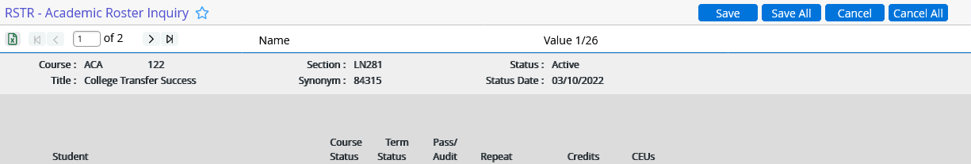

Export to Excel

Slide 22
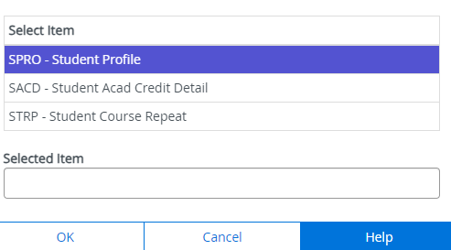
RSTR Continued
You can drill in to see details about a student by clicking on the form icon to the right of their name.

Slide 23
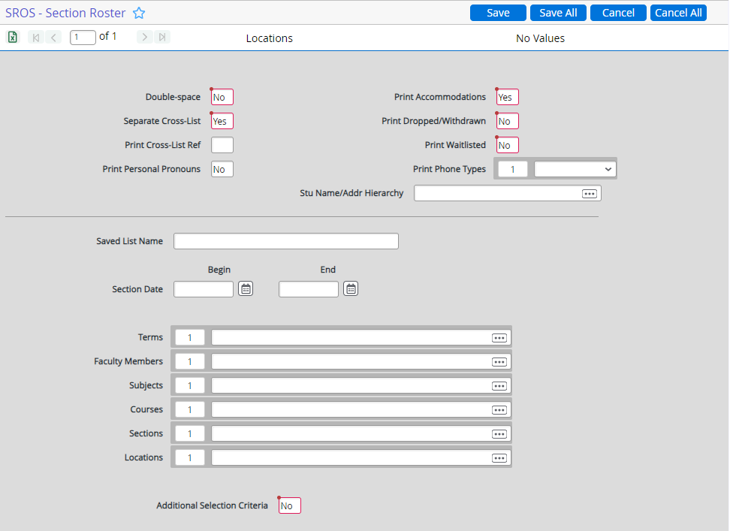
SROS
SROS is another roster option. This shows when students registered, added, dropped or withdrew. It also shows their advisors.
It’s a little more complicated to use, with multiple screens that need to be populated & saved.

Slide 24
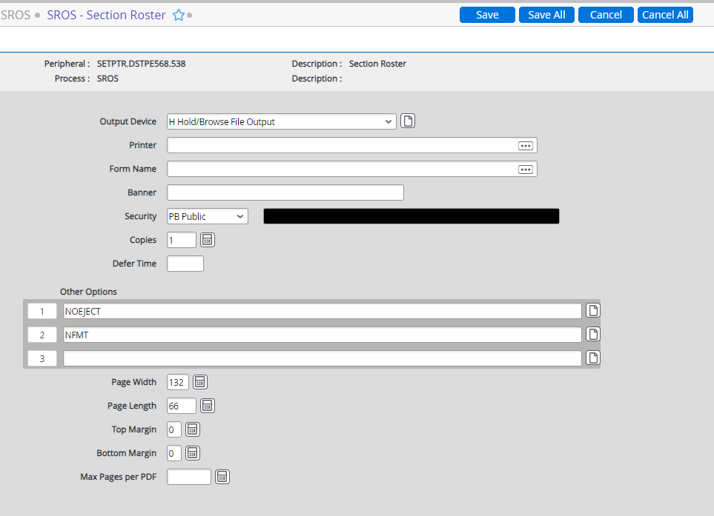
SROS Steps
Put in the section—start with the semester: 2024fa ENG-111-LL1
Click the blue save button.
Click Update.
Click Save.
Click update.
Make sure Output device is H for Hold.
Click Save & update again.
Click Save & update one more time.

Slide 25
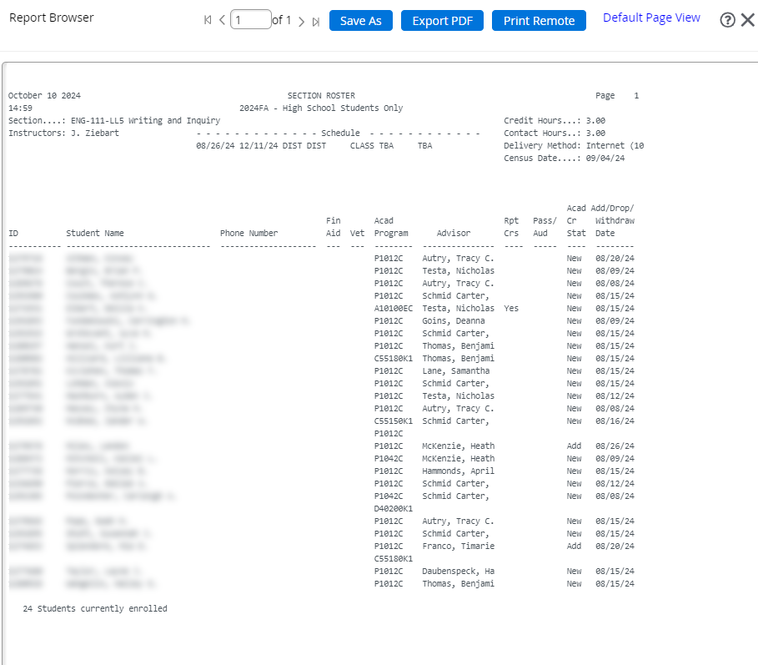
SROS Result

Slide 26
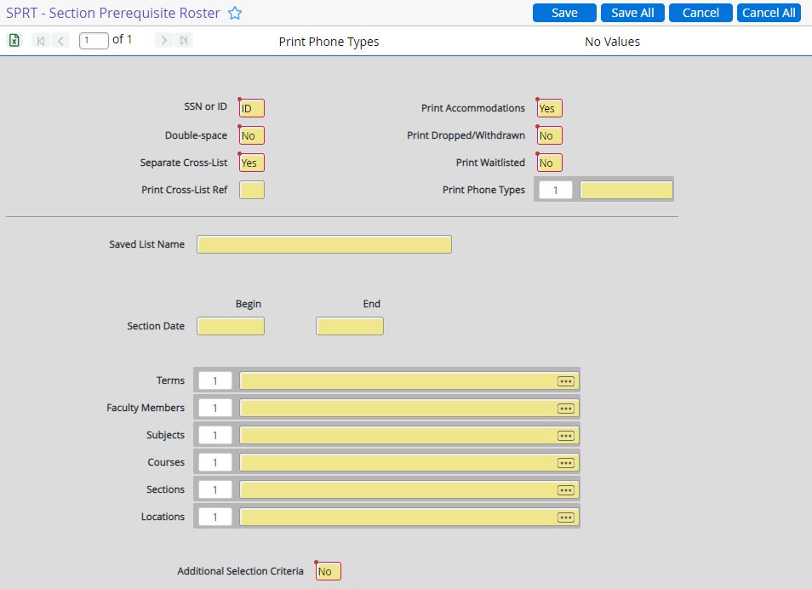
SPRT
SPRT lets you check prerequisites.
It works like SROS—you input the section and click through, saving and updating until you get the report.

Slide 27
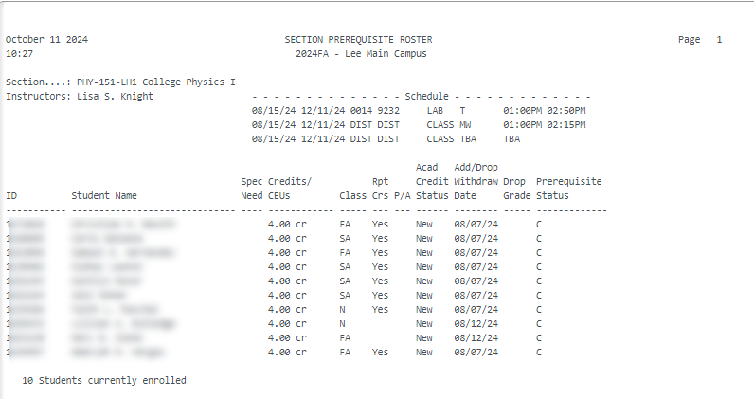
SPRT Report

Slide 28

Tips & Tricks
Semester format: YYYYSS = 2022FA, 2023SP, 2024SU
Always start with the year and semester when you begin a new registration session for students or it will default to the current semester.
@ will take you to the last record used (either person or form)
Most screens can be exported to Excel by clicking the Excel icon
Avoid printing unless you download to PDF and save locally to your device first, especially with transcripts. (These will print on fancy paper in the registrar’s office—don’t do it!)
Putting in … some fields will give you a menu/list of options.

Slide 29

Other less-frequently used Faculty mnemonics:
Questions?
Deana St. Peter, dstpe568@cccc.edu, x7396
EXTS – External transcripts
FADV—List of advisees
LOCR—Student locator

